Slide 1

Excel Level 1
Joan Zheng, QCL Graduate Fellow

Slide 2
Agenda
Workshop Overview
Learn how to move data around with SORT.
Learn how to highlight and hide data with Filter and Conditional Formatting.
Make a simple search feature with VLOOKUP (exact match).
Make simple Calculations about our data.
Put data in “bins” for visuals with FREQUENCY and bar charts.

Slide 3
Walkthrough
https://bit.ly/excel-level-1

Slide 4
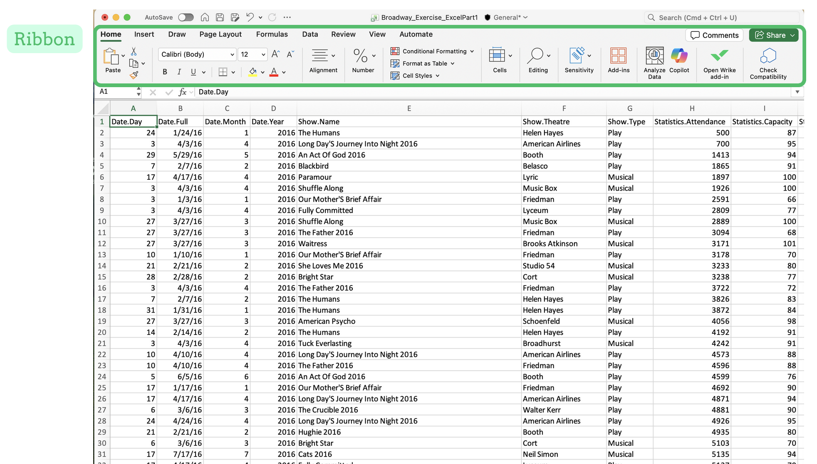
Excel Overview
The ribbon features all Excel Functions under various tabs.

Slide 5
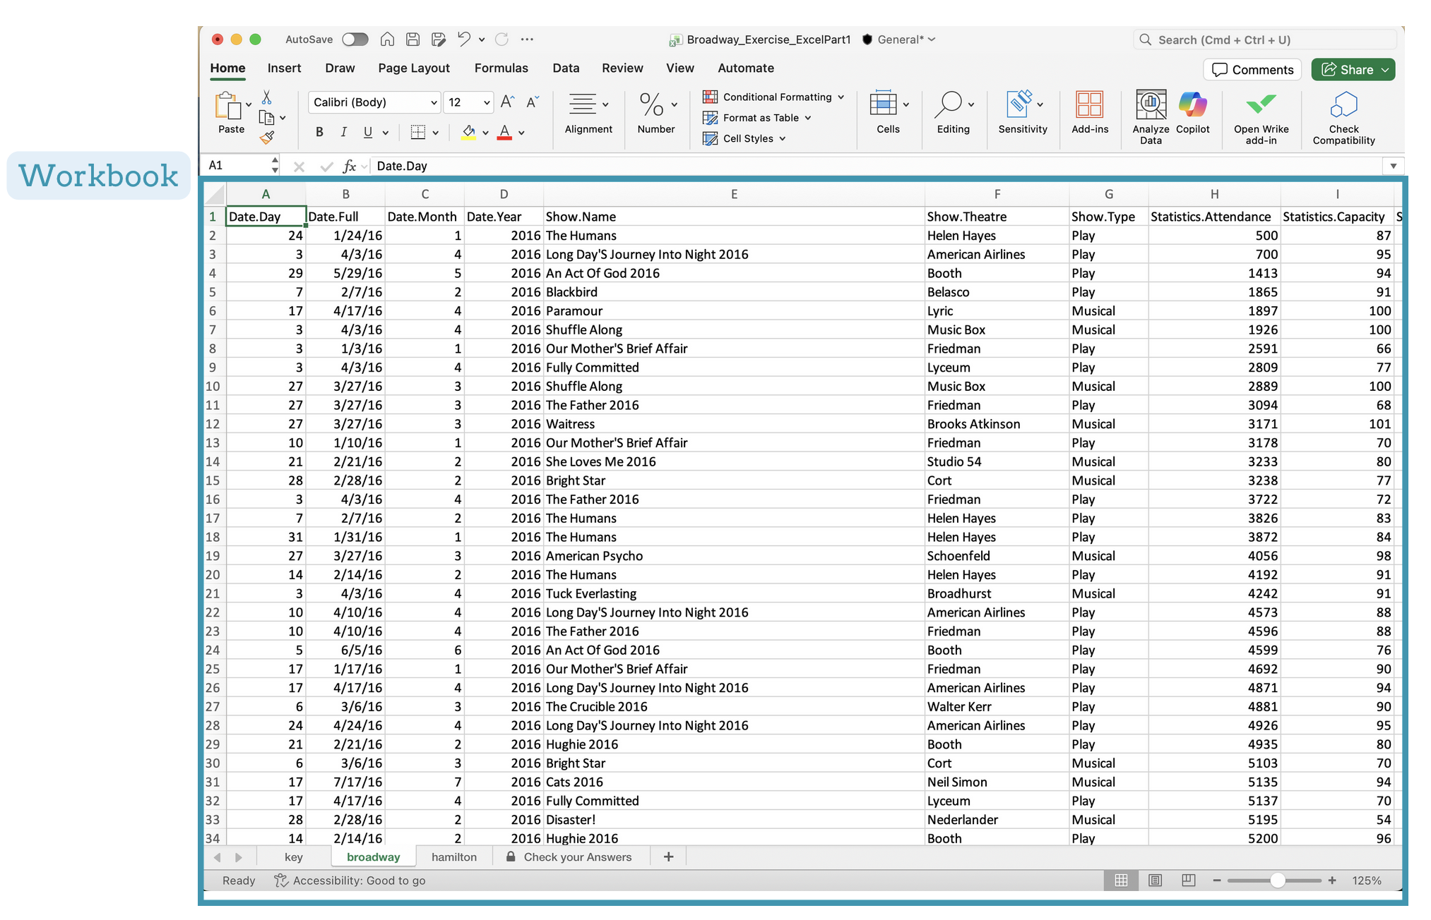
Excel Overview
The workbook is another word for Excel file, contains at least one worksheet or multiple sheets within the book.

Slide 6
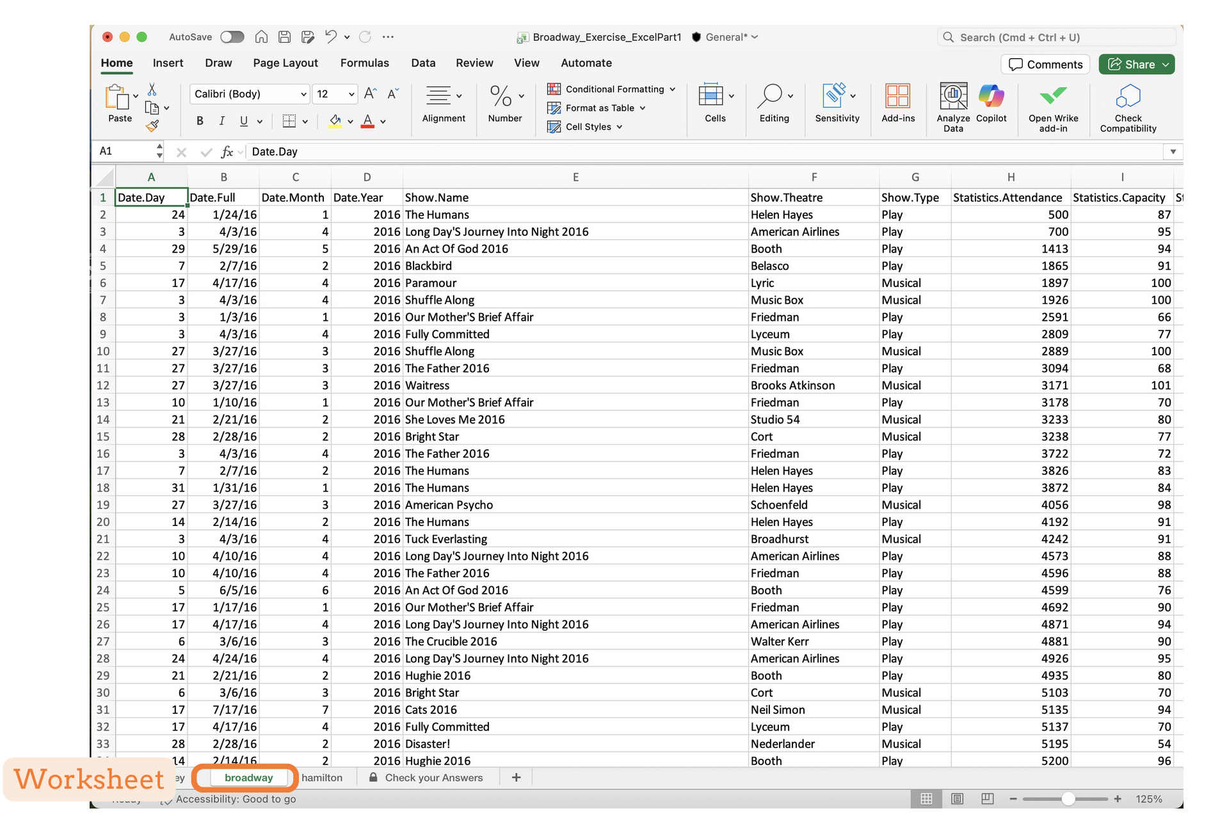
Excel Overview
A worksheet represents a single page of data in an Excel workbook.

Slide 7
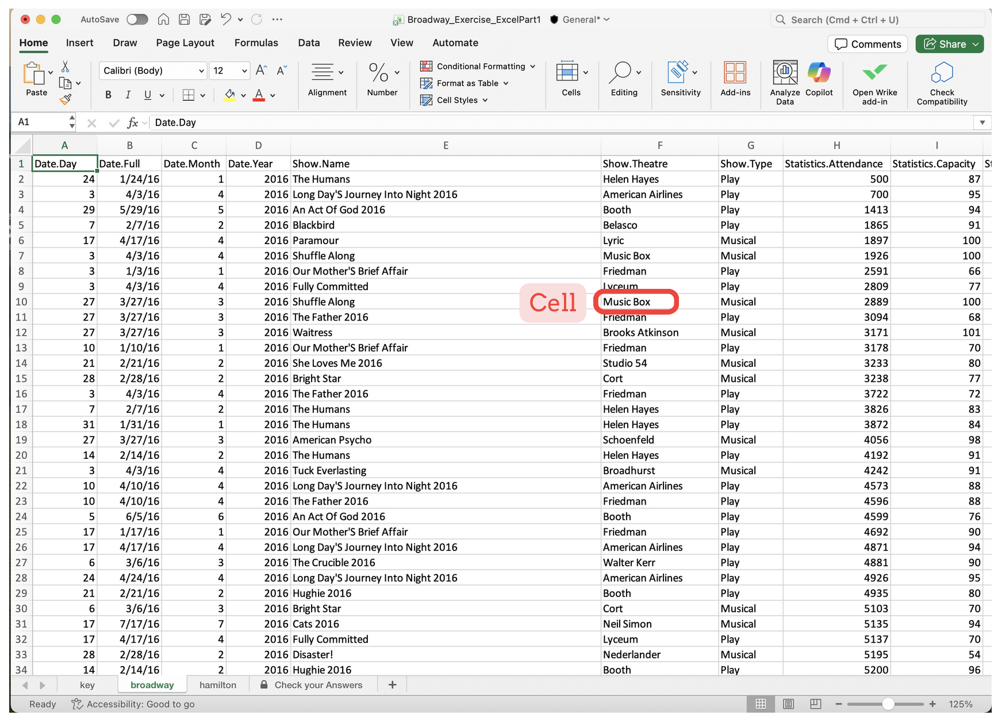
Excel Overview
Cells are basic building blocks of an Excel worksheet.

Slide 8
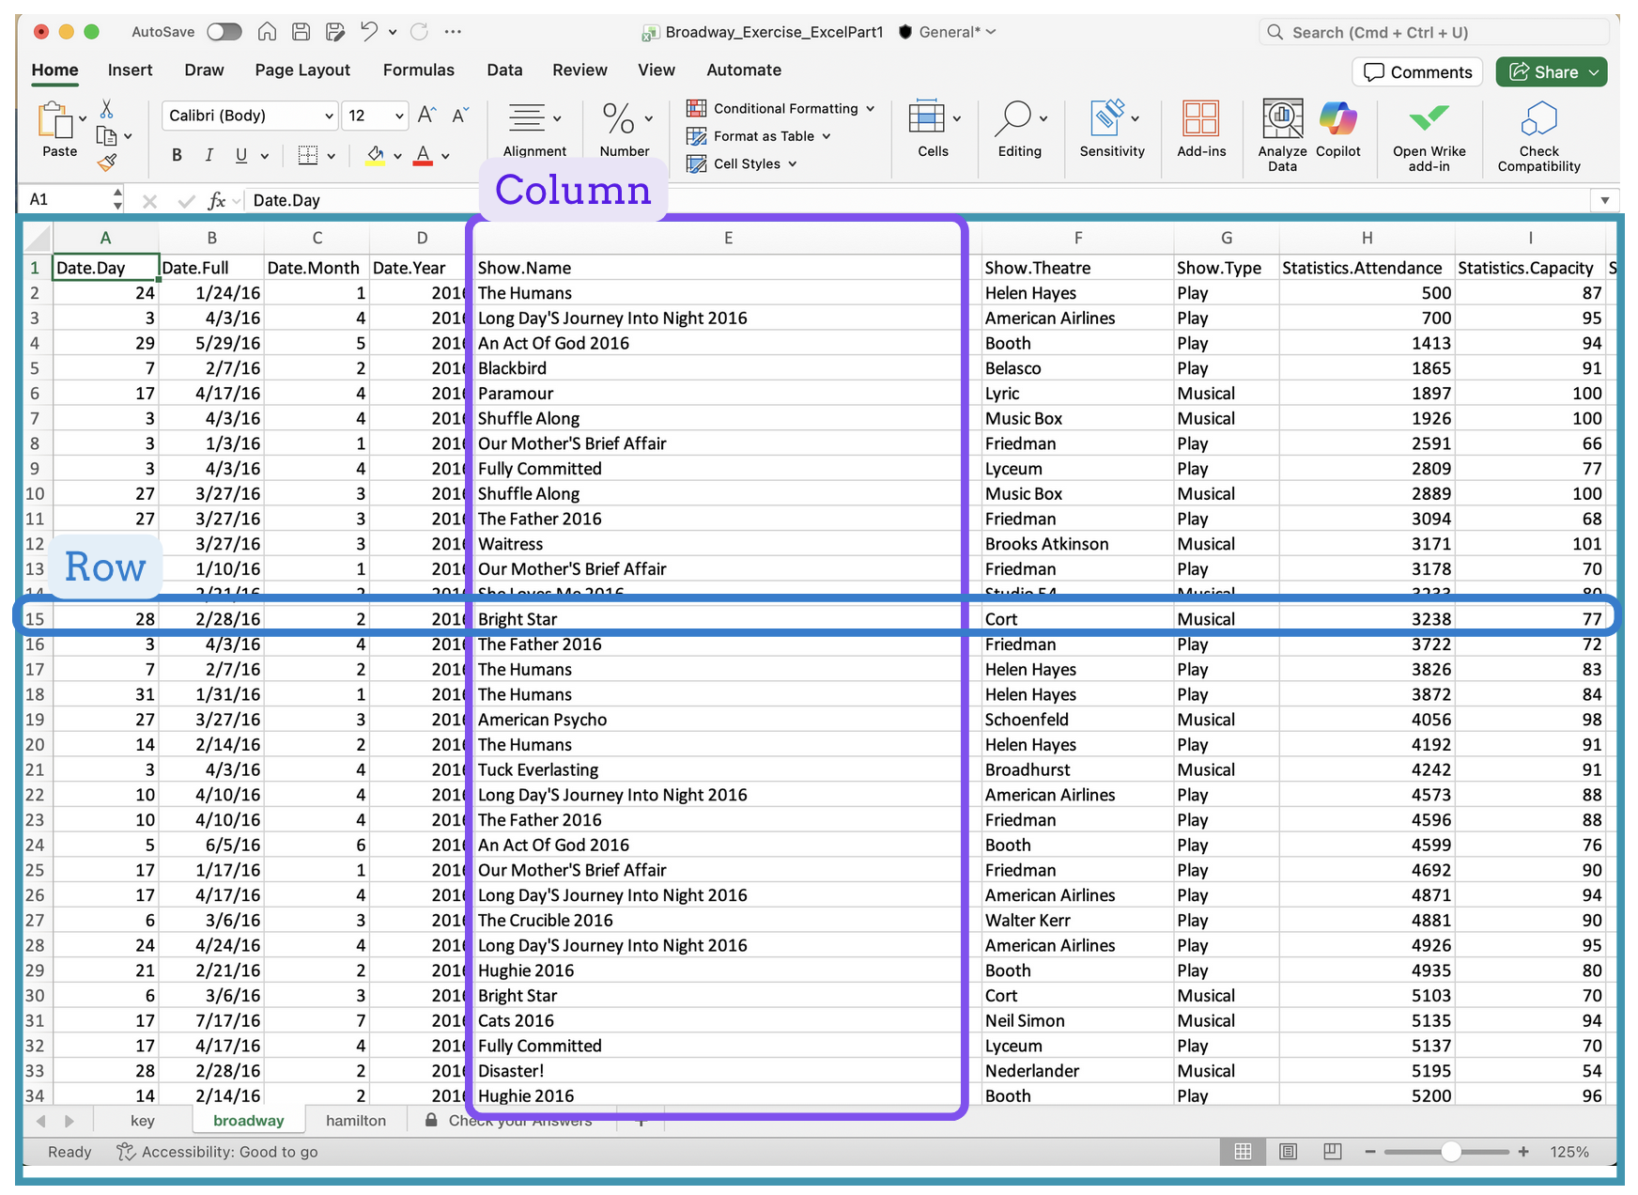
Excel Overview
Rows and columns represent horizontal and vertical lines of cells.

Slide 9
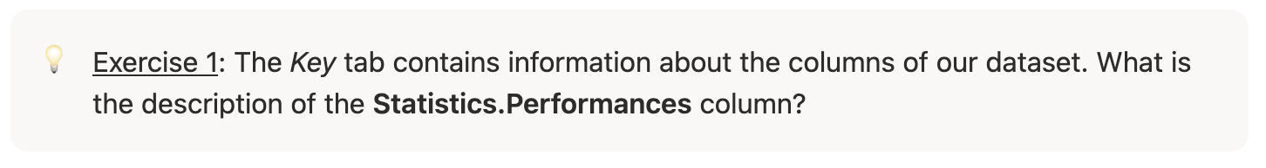
Excel Overview

Slide 10
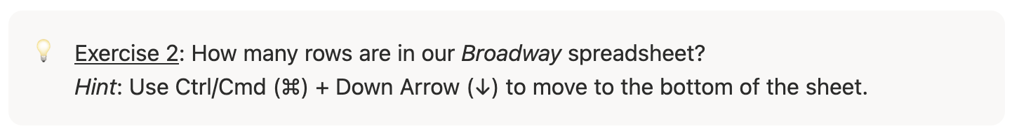
Excel Overview

Slide 11
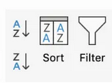
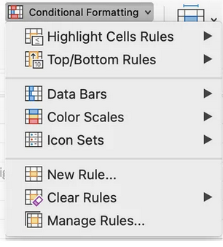
Key Excel Features

Slide 12
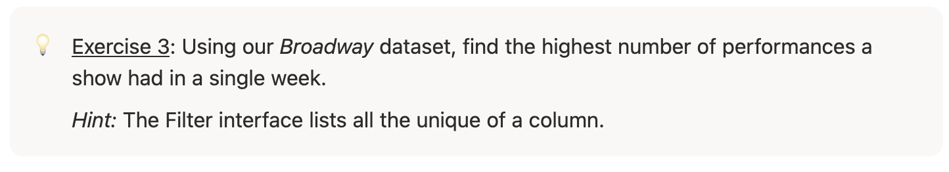
Key Excel Features: Sort and Filter

Slide 13
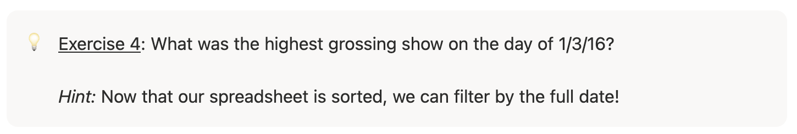
Key Excel Features: Sort and Filter

Slide 14

Key Excel Features: Conditional Formatting

Slide 15
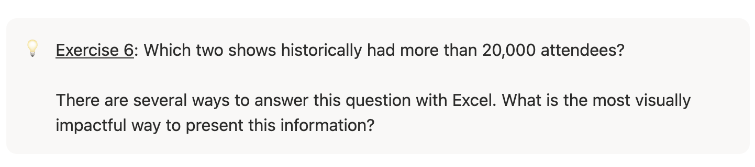
Key Excel Features: Conditional Formatting

Slide 16
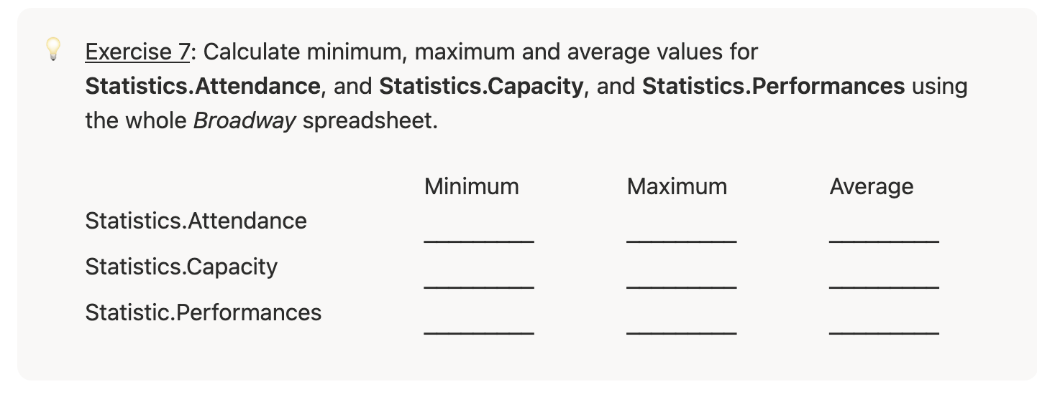
Calculations in Excel

Slide 17
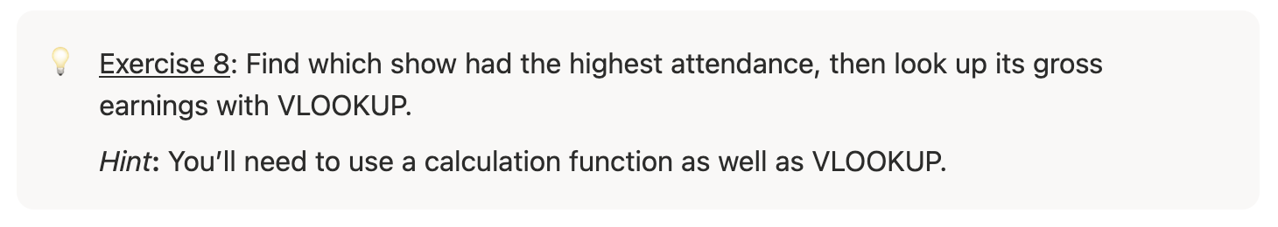
VLOOKUP Commands

Slide 18
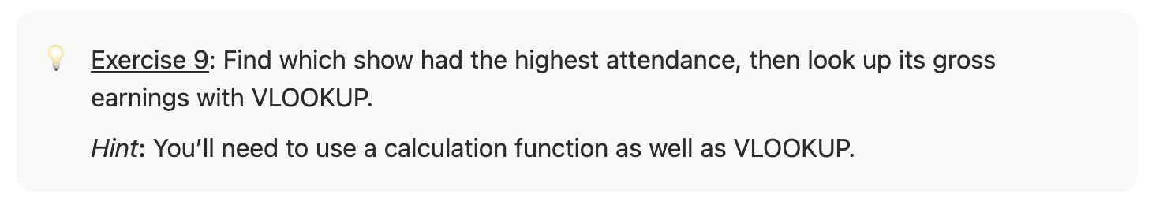
VLOOKUP Commands

Slide 19
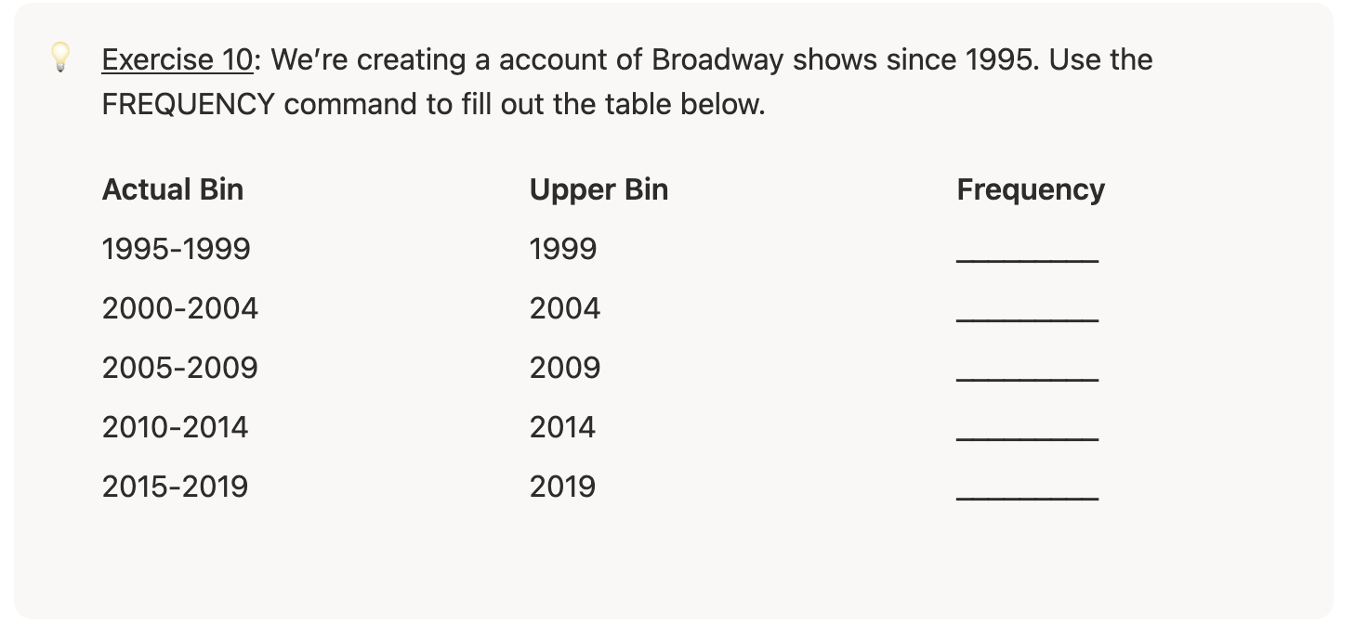
Frequency Command

Slide 20
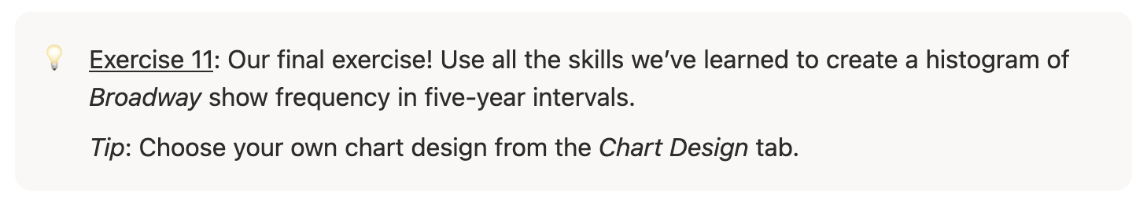
Histogram Exercise

